Slide 1
How to perform a budget query in self service
Banner 9
2024

Slide 2
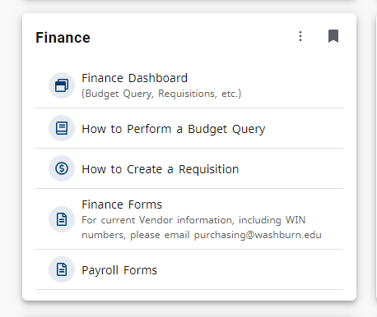
Accessing Banner 9 self-service
In MyWashburn, choose the Finance tile
Select “Finance Dashboard”

Slide 3
Getting Started
Click on My Finance Query

Slide 4
My finance query
To start a query, click on the “New Query” blue box in the upper right of the screen.

Slide 5
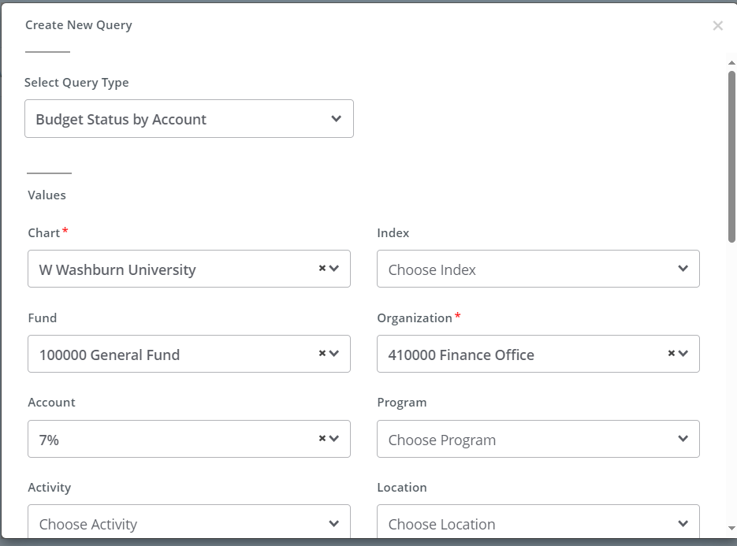
Query Type defaults to
“Budget Status by Account.”
Reminder, Account codes are broken into four categories. Following shows the beginning number and what it represents:
5 = Revenue
6 = Salary and Benefit
7 = Other Operating
8 = Transfers
Reference materials for FOAPAL and expense codes are on the Accounting website

Slide 6
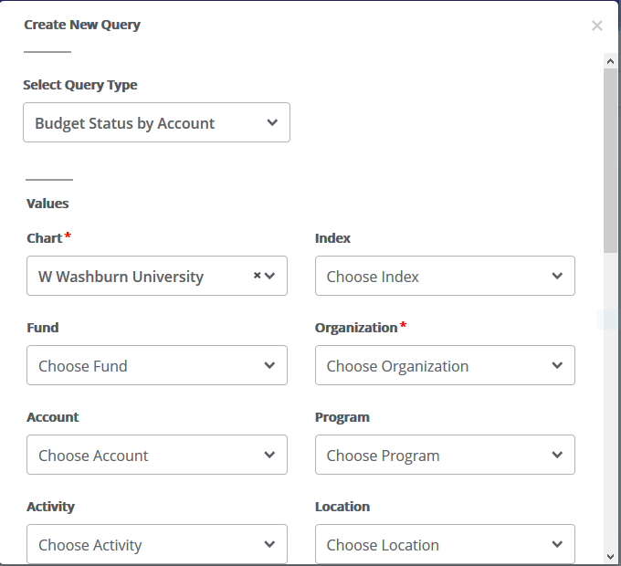
On this screen you will enter your query values.
Fill in query values as needed. See Page 10 for value descriptions.
Not all values are required.
Chart and Organization fields are required.
You can still use the wildcard for your selection (%) in a box
(continues on next page)

Slide 7
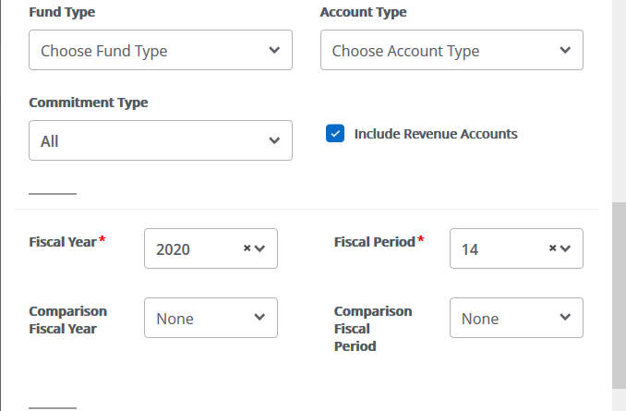
Scroll down screen for these items:
Check the box to “Include Revenue Accounts” if you want revenue accounts to pull into the query.
Select the “Fiscal Year” for the query.
If you want to compare years, enter a “Comparison Fiscal Year.”
Select the “Fiscal Period.” Period 14 is year to date including any year-end adjustments.
(continues on next page)

Slide 8
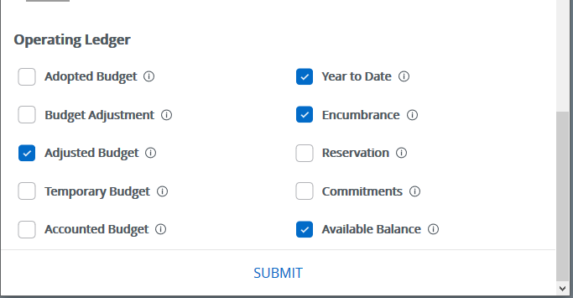
Select the columns you want to appear on the report generated by the query (see next page for column descriptions).
Click SUBMIT to run the query.

Slide 9
Description of Operating Ledger Data Columns
Adopted Budget | Original budget allocation given at the beginning of the Fiscal Year.
Budget Adjustment | Any additions or reductions made to the budget since the original allocation. This includes Both Permanent and Temporary adjustments.
Adjusted Budget | Current Budget. Adopted Budget plus or minus any Budget Adjustments. Total of all budget transactions. Details on actual transactions can be obtained by “drilling” down on this field.
Temporary Budget | Adjustments done in the current year that are temporary in nature. (Budget Adjustments that will not roll over to the next fiscal year.)
Accounted Budget | Current Budget. Adopted Budget plus or minus Temporary Budget
Year to date | Year-to-date activity. Represents actual revenue and expenditures posted.
Encumbrances | Generated by purchase orders; contracts or salary obligations; funds committed for future payments.
Reservation | Generated by purchase requisitions. Setting aside of budget.
Commitment | Equal to the total budget set aside for future obligations. Commitments= Reservations + Encumbrances.
Available Balance | Remaining Budget left to spend. = Accounted Budget +/- Commitments +/- Year to date

Slide 10
Field | Use
Fiscal year | The fiscal year you want to search in (usually the current year)
Fiscal period | The fiscal period you want to search in (there are 14 periods in a year). July is period 1 and June is period 12. Period 14 is year to date including any year-end adjustments.
Comparison Fiscal year | If you want to do a comparison between two time periods select the second fiscal year here
Comparison Fiscal period | If you want to do a comparison between two time periods select the second fiscal period here
Commitment Type | Leave as “All”
Chart of Accounts | W for Washburn, K for Washburn Institute of Technology
Index | Leave this blank
Fund | The fund code (usually 100000)
Activity | A code created by you to track specific types of spending
Organization | The department code

Slide 11
Field | Use
Organization | The department code
Location | A specific room or building
Grant | A specific grant
Fund Type | A specific fund type
Account | An item account number
Account Type | A specific account type
Program | The program code
Include Revenue Accounts | You can include revenue accounts along with the expenditure accounts by checking the box
Save Query As: | You can save the query by naming it in the box
Shared | You can share the query by checking the box

Slide 12
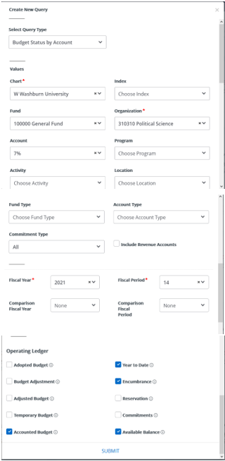
Sample budget query

Slide 13
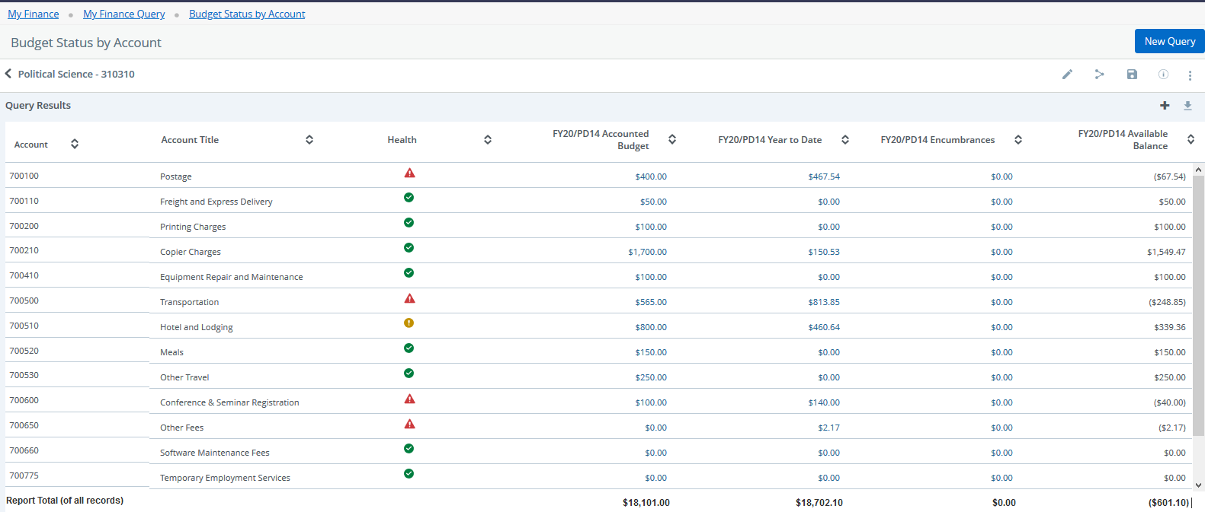
After you submit your budget query, the results display

Slide 14
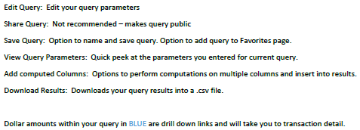
Edit Query
Save Query
Share Query
View Parameters
Download Results
Add Computed Columns

Slide 15
Clicking on the blue document codes will take you to a PDF of document

Slide 16
To Create a SAveD Query, click on the Save Icon
Type the Query Name
You can set the query as a “Favorite” by selecting the box.
Click on “Save”

Slide 17
To view Save Query
Click on “My Finance Query”
Click on “Favorites” if you saved the query as a Favorite.
Click on “Saved Queries” if you did not select the box for Favorites.

Slide 18
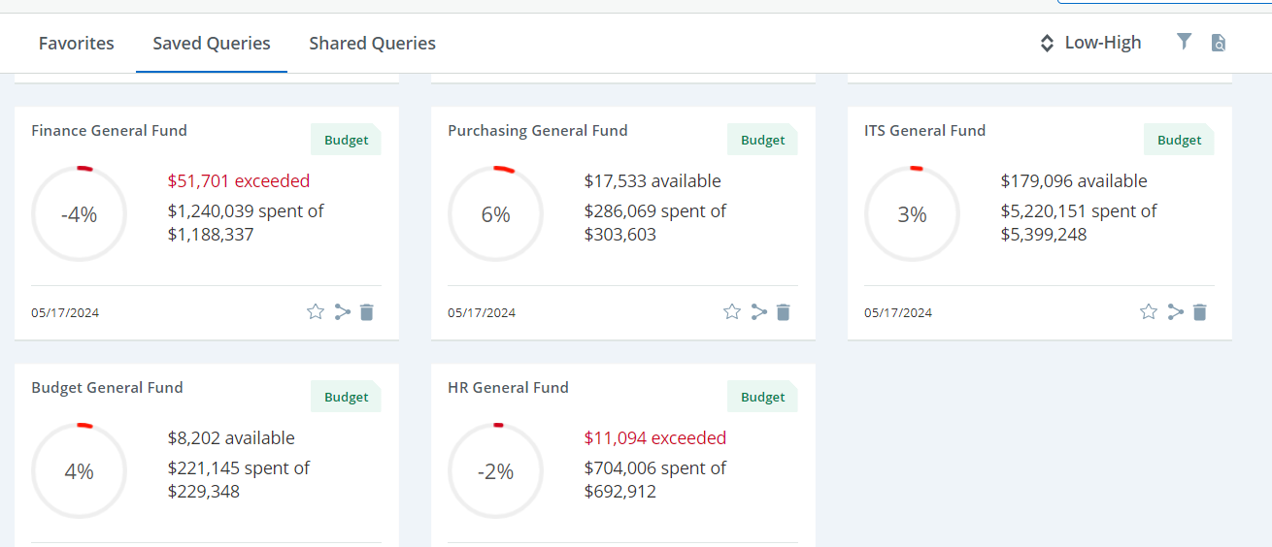
My finance query
This screen shows five saved queries. Note the two highlighted in yellow. These queries are showing these specific units have overspent their budget. This is recognized by the red amounts and the negative sign in the circle.

Slide 19
If you need any help with how to enter your department information in the query, please contact the Accounting Office or stop by Morgan Hall Rm 211.
Please contact ITS for other Banner 9 Technical issues or questions.

